Slide 1
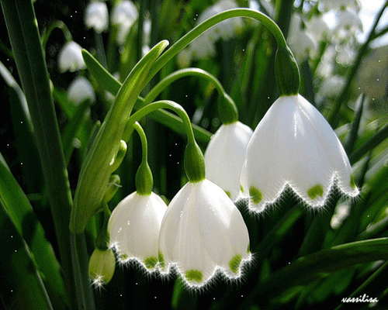
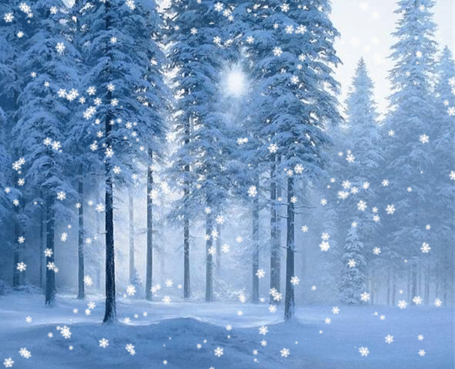
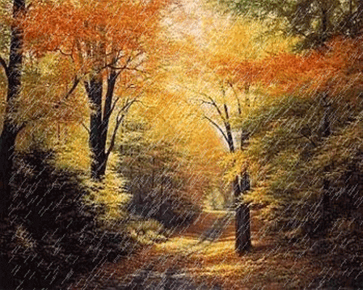
Seasons of the Year

Slide 2
Hello song

Slide 3
Seasons of the Year

Slide 4
The weather is good The weather is bad I think that the weather is fine
th
[θ] [ð]
thin this
thick that
month weather

Slide 5
Days of the week song

Slide 6
Seasons of the Year

Slide 11
Seasons of the Year

Slide 12
Reading
SEASONS
Winter, spring, summer and autumn are four seasons of the year.
It is cold in winter. It often snows. The trees and ground are white. The days are short, the nights are long in winter.
It is warm in spring. There are small green leaves on the trees. Birds sing their songs.
It is usually hot in summer. The days are long, the nights are short. Usually the sun shines and the sky is blue. Children don't go to school.
Autumn is a cool and wet season. But it is beautiful. The trees are yellow, red and brown. It often rains and it is windy. There are many apples and pears. School starts in autumn.

Slide 13
Writing Put the letters into the correct order to make up the words and fill in the sentences.
Winter, spring, summer and autumn are four­­­­­­­­­­­­­­­­­­­­­­­­­­­­­­­­­­­­­­__________of the
year. It often snows in __________. There are small green
_________ on the trees in spring. It is usually hot in
____________. Usually the sun shines and the _____ is blue.
Autumn is a ______ and wet season. But it is _______________.
nsaesos
twinre
seveal
ksy
remmsu
loco
eabuitful

Slide 14
Writing Put the letters into the correct order to make up the words and fill in the sentences.
Winter, spring, summer and autumn are four­­­­­­­­­­­­­­­­­­­­­­­­­­­­­­­­­­­­­­ seasons of the
year. It often snows in __________. There are small green
_________ on the trees in spring. It is usually hot in
____________. Usually the sun shines and the _____ is blue.
Autumn is a ______ and wet season. But it is _______________.
nsaesos
twinre
seveal
ksy
remmsu
loco
eabuitful

Slide 15
Writing Put the letters into the correct order to make up the words and fill in the sentences.
Winter, spring, summer and autumn are four­­­­­­­­­­­­­­­­­­­­­­­­­­­­­­­­­­­­­­ seasons of the
year. It often snows in winter. There are small green
_________ on the trees in spring. It is usually hot in
____________. Usually the sun shines and the _____ is blue.
Autumn is a ______ and wet season. But it is _______________.
nsaesos
twinre
seveal
ksy
remmsu
loco
eabuitful

Slide 16
Writing Put the letters into the correct order to make up the words and fill in the sentences.
Winter, spring, summer and autumn are four­­­­­­­­­­­­­­­­­­­­­­­­­­­­­­­­­­­­­­ seasons of the
year. It often snows in winter. There are small green
leaves on the trees in spring. It is usually hot in
____________. Usually the sun shines and the _____ is blue.
Autumn is a ______ and wet season. But it is _______________.
nsaesos
twinre
seveal
ksy
remmsu
loco
eabuitful

Slide 17
Writing Put the letters into the correct order to make up the words and fill in the sentences.
Winter, spring, summer and autumn are four­­­­­­­­­­­­­­­­­­­­­­­­­­­­­­­­­­­­­­ seasons of the
year. It often snows in winter. There are small green
leaves on the trees in spring. It is usually hot in
summer . Usually the sun shines and the _____ is blue.
Autumn is a ______ and wet season. But it is _______________.
nsaesos
twinre
seveal
remmsu
ksy
loco
eabuitful

Slide 18
Writing Put the letters into the correct order to make up the words and fill in the sentences.
Winter, spring, summer and autumn are four­­­­­­­­­­­­­­­­­­­­­­­­­­­­­­­­­­­­­­ seasons of the
year. It often snows in winter. There are small green
leaves on the trees in spring. It is usually hot in
summer . Usually the sun shines and the sky is blue.
Autumn is a ______ and wet season. But it is _______________.
nsaesos
twinre
seveal
remmsu
ksy
loco
eabuitful

Slide 19
Writing Put the letters into the correct order to make up the words and fill in the sentences.
Winter, spring, summer and autumn are four­­­­­­­­­­­­­­­­­­­­­­­­­­­­­­­­­­­­­­ seasons of the
year. It often snows in winter. There are small green
leaves on the trees in spring. It is usually hot in
summer . Usually the sun shines and the sky is blue.
Autumn is a cool and wet season. But it is __________.
nsaesos
twinre
seveal
remmsu
ksy
loco
eabuitful

Slide 20
Writing Put the letters into the correct order to make up the words and fill in the sentences.
Winter, spring, summer and autumn are four­­­­­­­­­­­­­­­­­­­­­­­­­­­­­­­­­­­­­­ seasons of the
year. It often snows in winter. There are small green
leaves on the trees in spring. It is usually hot in
summer . Usually the sun shines and the sky is blue.
Autumn is a cool and wet season. But it is beautiful
nsaesos
twinre
seveal
remmsu
ksy
loco
eabuitful

Slide 21
Seasons of the Year

Slide 22
Favorite season song

Slide 23
Speaking
What is your favorite season and why?

Slide 24
Seasons of the Year

Slide 25
Warm up
I like English

Slide 26
Seasons of the Year

Slide 27
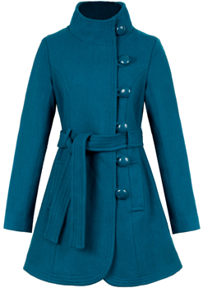
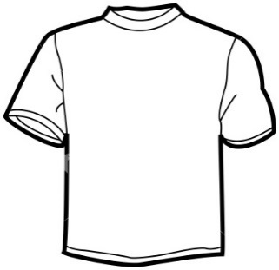
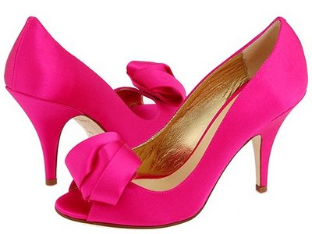
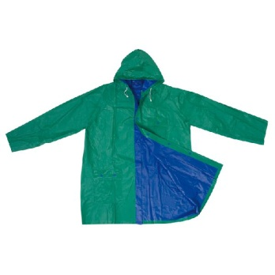
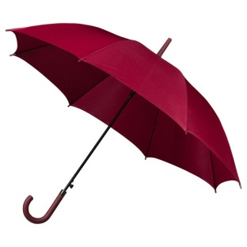
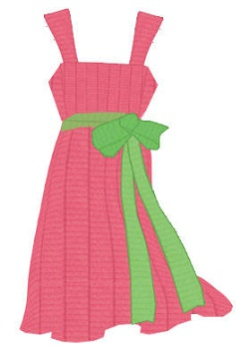
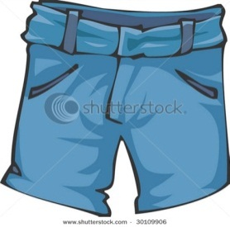
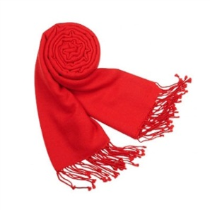
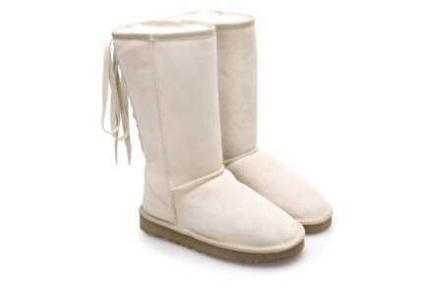

Slide 28
Listening
Colour the picture, what are they wearing?

Slide 29
Seasons of the Year

